Slide 1
One-Lung Ventilation for Thoracic Surgery
Eyayalem M(Assistant .Professor)
May. 2025

Slide 2
One-lung ventilation( OLV)
One-lung ventilation(OLV): means separation of the two lungs and each lung functioning independently by preparation of the airway
OLV provides:
Protection of healthy lung from infected/bleeding one
Diversion of ventilation from damaged airway or lung
Improved exposure of surgical field
OLV causes:
More manipulation of airway, more damage
Significant physiologic change and easily development of hypoxemia

Slide 3
Indication
Absolute
1. Isolation of one lung from the other to avoid spillage or contamination
Infection
Massive hemorrhage
2. Control of the distribution of ventilation
Bronchopleural fistula
Bronchopleural cutaneous fistula
Surgical opening of a major conducting airway
giant unilateral lung cyst or bulla
Tracheobronchial tree disruption
Life-threatening hypoxemia due to unilateral lung disease
3. Unilateral bronchopulmonary lavage
4. Video assisted Thoracoscopic surgery

Slide 4
RELATIVE 1. Surgical exposure—high priority
Thoracic aortic aneurysm
Pneumonectomy
Lung volume reduction
Minimally invasive cardiac surgery
Upper lobectomy
2. Surgical exposure—low priority
Esophageal surgery
Middle and lower lobectomy
Mediastinal mass resection, thymectomy
Bilateral sympathectomies

Slide 5
Methods of OLV
Double-lumen endotracheal tube, DLT
Single-lumen ET with a built-in bronchial blocker, Univent Tube
Single-lumen ET with an isolated bronchial blocker
Arndt (wire-guided) endobronchial blocker set
Balloon-tipped luminal catheters
Endobronchial intubation of a single-lumen ET

Slide 6
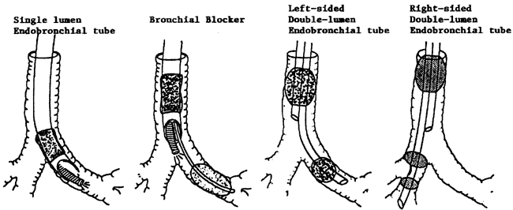
Methods of lung isolation

Slide 7
Double-lumen tubes (DLTs)
are the most commonly used devices to provide lung isolation.
are bifurcated tubes with a tracheal and a bronchial lumen, disposable, and made of polyvinyl chloride (PVC).
different sizes (28F, 32F, 37F, 39F, and 41F catheter), sides (left vs right)
Left-sided DLTs are used more often than right-sided

Slide 8
DLT…
For one-lung anesthesia during thoracic surgery a left-sided double-lumen endobronchial tube (DLT) is preferred over a right-sided DLT because of its greater margin of safety for correct positioning in the left mainstem bronchus (LMB)

Slide 9
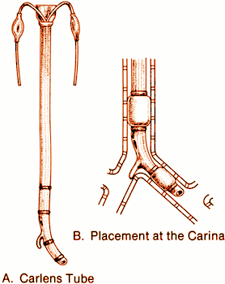
DLT…
Type:
Carlens, a left-sided + a carinal hook
White, a right-sided Carlens tube
Robertshaw, most widely used
All have two lumina/cuffs, one terminating in the trachea and the other
in the mainstem bronchus
Right-sided or left-sided available
Available size: 41,39, 37, 35, 28 French (ID=6.5, 6.0, 5.5, 5.0 and 4.5 mm respectively)
Most women will need a 37-FrDLT & most men will need #39 Fr- DLT

Slide 10
Components of double- lumen tube package
Double- lumen tube
Adaptor for ventilation of both ports
Extension for each port
Stylet
Suction catheter

Slide 11
Components of double- lumen tube package
Apparatus to deliver continuous positive pressure airway to the nonventilated lung (variable
depending on manufacturer)
Additional equipment:
Laryngoscope blade
Fiberoptic bronchoscope
Stethoscope
Hemostat to clamp the tube extension on the nonventilated side

Slide 12
Types of Double lumen Tube

Slide 13
DLT SIZE SELECTION
Iatrogenic injury has been estimated to occur in 0.5 to 2 per 1,000 cases with DLTs.
View the chest x-ray film or CT scan, which can help predict the majority of difficult endobronchial intubations.
Use an appropriate size tube. Too small a tube will make lung isolation difficult. Too large a tube is more likely to cause trauma. Useful guidelines for DLT sizes in adults are as follows:

Slide 14
DLT SIZE SELECTION
Females' height < 1.6 m (63 inch): 35 Fr
Females > 1.6 m: 37 Fr
Males < 1.7 m (67 inch): 39 Fr (possibly 37 Fr if < 1.6 m)
Males > 1.7 m: 41 Fr

Slide 15
Choice of double lumen tube

Slide 16
Depth of insertion of DLT
Tracheobronchial dimensions correlate with height.
The average depth at insertion, from the teeth, for a left DLT is 29 cm in an adult and varies ± 1 cm for each 10 cm of patient height above/ below 170 cm.
Avoid nitrous oxide. Nitrous oxide 70% can increase the bronchial cuff volume from 5 to 16 mL intraoperatively.

Slide 17
Inflate the bronchial cuff/blocker only to the minimal volume required for lung isolation and for the minimal time.
This volume usually is less than 3 mL. Inflating the bronchial cuff does not stabilize the DLT position when the patient is turned to the lateral position.

Slide 18
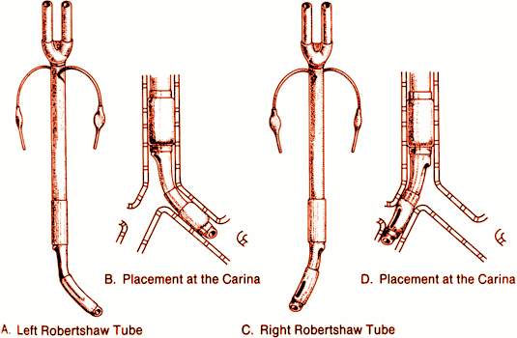
The Robert show Double Lumen Left LDT
Most commonly used
The bronchial lumen is longer, and a simple round opening and symmetric cuff⬇ Better margin of safety than Rt DLT
Easy to apply suction and/or CPAP to either lung
Easy to deflate lung
Lower bronchial cuff volumes and pressures
Can be used
Left lung isolation:
clamp bronchial +
ventilate/ tracheal lumen
Right lung isolation:
clamp tracheal +
ventilate/bronchial lumen

Slide 19
Inserting /Positioning DLT
Before insertion prepare &check the tube high volume &low pressure about 20 ml &bronchial cuff is small, check with 3 ml syringe.
The tube’s performed curvature mackintosh blade 3 is preferred for intubations because it provides the largest area through which to pass the tube.

Slide 20
Inserting/ Positioning DLT
Insert with the distal concave curvature facing anteriorly.
After the tip of the tube is past the vocal cords, remove the stylet &rotate the tube 90 degrees.
The left sided tube is rotated 90 degree to the left.
The right tube is rotated 90 degree to the right.

Slide 21
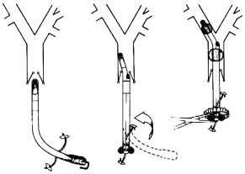

Slide 22
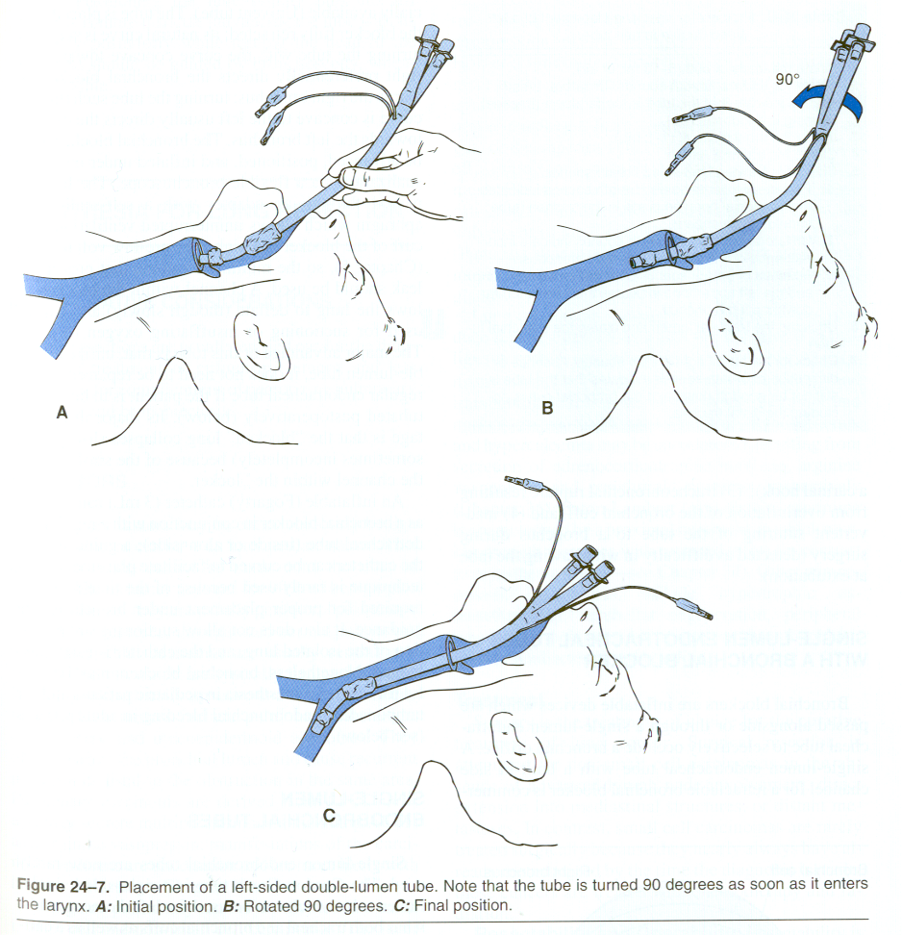

Slide 23
Inserting/ Positioning DLT
Advancement of the tube ceases when moderate resistance to further passage is encountered, indicating that the tube tip has been firmly seated in the main stem bronchus.
Once the tube is thought to be in the proper position a sequence of steps should be performed to check its location

Slide 24
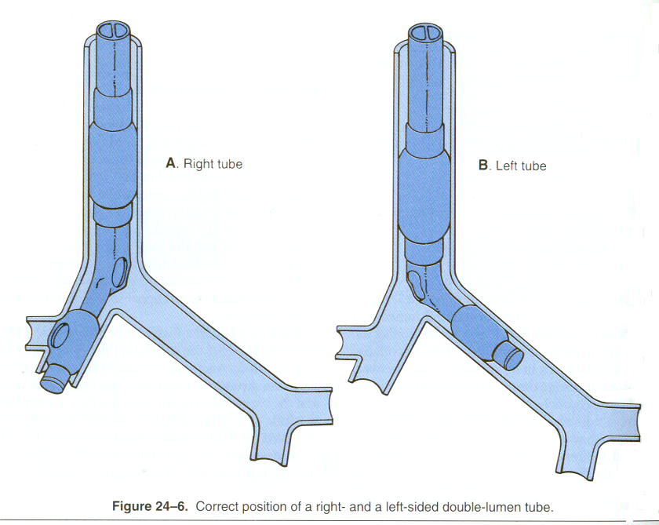

Slide 25
check its location
1st step :-the tracheal cuff –inflate &equal ventilation of both lungs,
if unequal breathe sounds the tube probable too far down &tracheal lumens in maistem bronchus or is lying at the carina-withdraw 2-3 cm it restores equal breath sounds.

Slide 26
check its location
2nd step: - is to clamp the right side (in case of left sided tubes)
Inflate bronchial cuff slowly with 2ml of air enough to avoid excessive pressure on the bronchus &helps to avoid laceration.

Slide 27
check its location
3rd step:- remove the clamp & check both lungs are ventilated with both cuffs inflated.
To ensure bronchial cuff is not obstructing the contralateral hemithorax either totally or partially.

Slide 28
check its location
Final step :- selectively clamp each side &watch for absences of movement &breath sounds on the ipsilateral (clamped) side, the ventilated side should have a clear breathe sounds &chest movement.

Slide 29
check its location
Other methods to ensure position of a DLT
fluoroscopy
chest x-ray
selective capnography
use of an under water seal
pediatric fiberoptic bronchoscope
Continuous spirometry &clinical observation

Slide 30
…Left DLT
Contraindication:
Presence of lesion along DLT pathway
Difficult/impossible conventional direct vision intubation
Critically ill patients with single lumen tube in situ who cannot tolerate even a short period of off mechanical ventilation
Full stomach or high risk of aspiration
Patients, too small (<25-35kg) or too young (< 8-12 yrs)

Slide 31
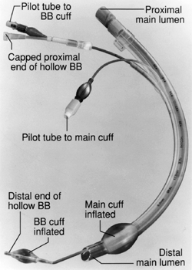
Univent Tube...
Developed by Dr. Inoue
Movable blocker shaft in external lumen of a single-lumen ET tube
Easier to insert and properly position than DLT (diff airway, C-s injury, pedi or critical pts)
No need to change the tube for postop ventilation
When the blocker is inflated, that lung will not be ventilated
Selective blockade of some lobes of the lung
Suction and delivery CPAP to the blocked lung

Slide 32
...Univent Tube
Slow deflation (need suction) and inflation (short PPV or jet ventilation)
Blockage of bronchial blocker lumen
Higher endobronchial cuff volumes +pressure (just-seal volume recommended)
Higher rate of intraoperative leak in the blocker cuff
Higher failure rate if the blocker advanced blindly

Slide 33
Other Methods of OLV
Single-lumen ETT with a balloon-tipped catheter
Including Fogarty embolectomy catheter, Magill or Foley, and Swan-Ganz catheter (children < 10 kg)
Not reliable and may be more time-consuming
Inability to suction or ventilate the blocked lung
Endobronchial intubation of single-lumen ETT
The easiest and quickest way of separating one lung from the other bleeding one, esp. from left lung
More often used for pedi patients
More likely to cause serious hypoxemia or severe bronchial damage

Slide 34
Problems of malposition of DLT
DLT in wrong bronchus
DLT may be passes too far down either the right or left mainstem bronchus
DLT not inserted for enough
A right-sided DLT may occlude the right upper lobe orifice.
The left upper lobe orifice may be obstructed by a left side DLT.
Bronchial cuff herination & may obstruct the bronchial lumen
Rare complication
tracheal rupture,
over inflation of the bronchial cuff,
inappropriate positioning

Slide 35
ANESTHETIC MANAGEMENT

Slide 36
ANESTHETIC MANAGEMENT
Induction of Anesthesia
The selection of an induction agent should be based on the patient’s preoperative status.
All patients should receive adequate preoxygenation before induction.
An adequate depth of anesthesia will help prevent reflex bronchospasm and exaggerated cardiovascular pressor responses to laryngoscopy

Slide 37
ANESTHETIC MANAGEMENT
This may be accomplished by incremental doses of the induction agent, an opioid, or deepening the anesthesia with a volatile inhalation agent
GA with thoracic epidural analgesia, intercostal block, paravertebral block

Slide 38
ANESTHETIC MANAGEMENT
In Thoracic surgical patients ,there is Risk of increased airway reactivity & bronchoconstriction, as the patients are chronic smokers, has chronic bronchitis & or COPD.
Surgical manipulations of the airway & bronchial tree by instrument, DLT, or the surgeon make bronchoconstriction more likely to occur
Halothane, enflurane & isoflurane - decrease airway irritability & bronchoconstriction provoked by hypocapnea or inhaled or irritant aerosols - which makes them the drug choice

Slide 39
Anesthetic Considerations
Halothane is preferable for inhalation induction as it is least pungent but once the patient asleep isoflurane may be preferable because it raises cardiac arrhythmia threshold & provide greater CV – stability.
Nitrous oxide - narcotic - relaxant anesthesia can be used but N₂O necessitates a significance decrease in FIO2 & high chance of hypoxia.

Slide 40
Anesthetic Considerations
Fentanyl does not influence bronchmotor tone but morphine does by a central Vagotonic effect & by histamine release.
In most patients, anesthesia is safely induced with propofol or etomidate.
In patients with reactive airway, ketamine may be preferred as it is used in the treatment of asthma successfully.
Thiopentone has been associated with bronchospasm in asthmatic patients, although it is related with inadequate level of anesthesia before instrumentation of the airway.
Notes:
Histamine releasing effect of thiopentone may induce broncospasm.

Slide 41
Anesthetic Considerations
The choice of muscle relaxants are those that lack histamine releasing or vagotonic effect & have some sympatomimetic effect pancuronium & vecronium are the drug of choice.
Succinylcholine can be used for rapid relaxation & intubations not associated with an increase in airway reactivity.

Slide 42
Anesthetic Considerations
IV - lidocaine (1-2 mg/kg) before manipulation of the airway to prevent reflex bronchosposm.
It is also given by infusion to depress airway - reactivity in patients.
IV - lidocaine allow to treat brochospasm occurring during anesthesia.
Atropine - for antimuscarinic effects of acetylcholine & protect cholinergic induced bronchoconstriction..

Slide 43
Positioning
Following induction, intubation, and confirmation of correct tracheal or bronchial blocker position, additional venous access and monitoring may be obtained before the patient is positioned for surgery.
Most lung resections are performed with the patient in the lateral decubitus position.
Proper positioning avoids injuries and facilitates surgical exposure

Slide 44
Positioning

Slide 45
FLUID MANAGEMENT
Following lung resection, there is an increased potential for pulmonary edema to develop.
Right pneumonectomy is associated with the highest risk of this complication-which is associated with a high mortality
Pulmonary edema may develop due to several factors.

Slide 46
FLUID MANAGEMENT
Following pneumonectomy, the entire pulmonary blood flow is directed into the remaining lung, raising pulmonary vessel hydrostatic pressures.
In addition, loss of lymphatic drainage occurs about one half of the lymphatic drainage of the left lung occurs via the right lung, this

Slide 47
FLUID MANAGEMENT
For the above reasons, it is important to avoid fluid over load in the first hour intraopratively and 1.5 L in the first 24 hours post operatively.
Intravenous fluids are administered to replace volume deficits and for maintenance only during lung resection anesthesia
No volume is given for “third space” losses
Blood transfusion should be commenced at the usual clinical triggers.
If colloids have been administered, they may worsen the severity of subsequent pulmonary edema as they cannot be resorbed as quickly as crystalloid and hence should be avoided

Slide 48
FLUID MANAGEMENT
Why pulmonary edema is more dangerous in this patients?

Slide 49
MANAGEMENT OF ONE-LUNG VENTILATION
Inspired Oxygen Fraction
An FIO2 (fraction of inspired oxygen) of 1.0 is generally recommended during OLV.
High oxygen concentration serves to protect against hypoxemia during the procedure and provides a higher margin of safety.
What is the effect of using high FIO2????

Slide 50
MANAGEMENT OF ONE-LUNG VENTILATION
Inspired Oxygen Fraction
A high FIO2 may, however, cause absorption atelectasis and potentially further increase the amount of shunt because of the collapsed alveoli

Slide 51
Management of OLV...
Initial management of OLV anesthesia:
Maintain two-lung ventilation as long as possible
Use FIO2 = 1.0
TV-Two strategies:
high tidal volume (10-12 ml/kg) without PEEP or
moderate tidal volume (6-8 ml/kg) with PEEP
Adjust RR (increasing 20-30%) to keep PaCO2 = 40 mmHg
Continuous monitoring of oxygenation and ventilation (SpO2, ABG and ET CO2)

Slide 52
...Management of OLV
If severe hypoxemia occurs, the following steps be taken
Check DLT position with FOB
If left thoracotomy ensure ventilation of right upper lobe
Check hemodynamic status
CPAP (5-10 cm H2O, 5 L/min) to nondependent lung, most effective
PEEP (5-10 cm H2O) to dependent lung, least effective
Intermittent two-lung ventilation
Other causes of hypoxemia in OLV
Mechanical failure of 02 supply or airway blockade
Hypoventilation
Resorption of residual 02 from the clamped lung
Factors that decrease Sv02 (↓CO, ↑02 consumption)

Slide 53
Broncho-Cath CPAP system

Slide 54
Hypoxic pulmonary vasocontriction(HPV)
HPV, a local response of pulmonary artery smooth muscle, decreases blood flow to the area of lung where a low alveolar oxygen pressure is sensed.
The mechanism of HPV is not completely understood. Vasoactive substances released by hypoxia or hypoxia itself (K+ channel) cause pulmonary artery smooth muscle contraction
HPV aids in keeping a normal V/Q relationship by diversion of blood from underventilated areas, responsible for the most lung perfusion redistribution in OLV
HPV is graded and limited, of greatest benefit when 30% to 70% of the lung is made hypoxic.
But effective only when there are normoxic areas of the lung available to receive the diverted blood flow

Slide 55
Factors that inhibit hypoxic pulmonary vasoconstriction***
Inhibitors of HPV include
Mitral stenosis,
volume overload,
thormboemblism,
hypothermia &
vasocdialators drugs, and
a large hypoxic lung segment.
Direct inhibitors of HPV include infection; vasodialator drugs, such as nitroglycerin & nitroprusside; hypocarbia & metabolic alkalemia.

Slide 56
Potentiators of HPV
Almitrine may potentiate HPV. It is a respiratory stimulant drug.It has been found to improve PaO₂ in patients with COPD.
Almitrine is nonspecific pulmonary vasoconstrictor.
Prostaglandins may play a role in HPV inhibition, & therefore prostaglandin inhibitors have been investigated as potentiators of HPV.
Ibuprofen & a cyclooxygenase inhibitor have been found to potentiate HPV in Hypoxic lung.

Slide 57
Termination of surgery and anesthesia
Testing of bronchial suture lines
On completion of lung resection, the bronchial suture lines &lung surfaces are tested for an air leak.
Sterile water is instilled into the pleural cavity following cancer surgery, to cover the bronchial suture lines.
After lobectomy, the remaining lobes are then suctioned before reinfilation.
In the case of pneumonectomy, very gentile suction is applied with a soft catheter to the bronchial sump.
At this stage it may be helpful to deflate the bronchial cuffs.
In the unlikely event of leak being present, gas bubbles will be seen appearing below the water level in the pleural cavity, indicating the need for further surgery.

Slide 58
Termination of anesthesia
ETT is removed when the patent’s respiratory effort is satisfactory.
A similar sequence is followed after pneumonectomy but the remaining lung is reinfilated until the trachea is approximately central or slightly towards the side of surgery.
The chest drain, if inserted, is then clamped.
If a chest drain has not been used after pneumonectomy,it may be necessary to aspirate air from the hemithorax on the side of surgery to optimize the position of the mediastinum.
Place-sitting position after removal of DLT allowed to breath O₂ enriched air.

Slide 59
Termination of anesthesia
ETT is removed when the patient’s respiratory effort is satisfactory.
A similar sequence is followed after pneumonectomy but the remaining lung is reinflated until the trachea is approximately central or slightly towards the side of surgery.
The chest drain, if inserted, is then clamped.
If a chest drain has not been used after pneumonectomy, it may be necessary to aspirate air from the hemithorax on the side of surgery to optimize the position of the mediastinum.
Place-sitting position after removal of DLT allowed to breathe O₂ enriched air.

Slide 60
Postoperative Complications and Management
1-Atelectasis: the most significant cause of postop morbidity
- Prevention & treatment of atelectasis
. Use of incentive spirometry
. Bronchodilators
. Coughing
. Clearance of secretions - positioning - postural
drainage LDP
. Mobilizing the patient
. Adequate analgesia

Slide 61
Postoperative Complications and Management
2-Low CO-syndrome & postop cardiac arrhythmias
3- Postop fluid administration can lead to pulmonary oedema
4-Postop pulmonary embolism
5- Postop cardiac arrhythmias
6- Hemorrhage & pneumothorax
7-Dehiscence of bronchial stump
8-Both- Central & peripheral neurologic injuries
9-Recurrent laryngeal nerve:-

Slide 62
Postoperative Pain Control
Adequate postop analgesia is necessary to ensure a good respiratory effort.
Patient Controlled Analgesia (PCA)
Intercostals nerve block before, during, after thoracic surgery
Epidural morphine
Interpleural analgesia:

Slide 63
Thanks for Your Attention

